Slide 1

Real-Time Fire and Smoke Detection System Using YOLOv9 with Intelligent Alerting
by
D. Neha Anjum
Roll No. 224G1A0559
V. Meghana
Roll No. 234G5A0507
S. Mohammad Anees
Roll No. 224G1A0553
Under the guidance of
Dr. D. Rajesh Babu _{M.Tech.,} _{Ph.D}
_{Associate Professor}
Department of Computer Science and Engineering
Srinivasa Ramanujan Institute of Technology
Autonomous
Rotarypuram Village, B K Samudram Mandal, Ananthapuramu – 515701.
Accredited by NBA & NAAC with “A” Grade,Affiliated to JNTUA,Ananthapuramu
2025-2026

Slide 2
Title Explaination
Real-Time Fire and Smoke Detection System Using YOLOv9 with Intelligent Alerting
Improved Fire Detection Algorithm The title highlights the development of an enhanced fire detection approach that focuses on improving accuracy, reliability, and real-time performance compared to traditional and existing fire detection methods.
YOLOv9-Based Framework The inclusion of YOLOv9 indicates the use of a state-of-the-art deep learning object detection model, chosen for its fast inference speed and high detection precision, making it suitable for real-time fire and smoke detection.
Real-Time Fire and Smoke Monitoring The title emphasizes real-time monitoring, where live video streams are continuously analyzed to detect fire or smoke incidents at an early stage, enabling timely response and prevention.
Automated Alert and Safety Management The title reflects the system’s capability to automatically validate fire events, assess severity, and trigger emergency alerts, ensuring efficient safety management and rapid disaster response.

Slide 3
Contents
Abstract
Introduction
Software Requirements
Datasets/Modules
Implementation
Outputs
Conclusion
References

Slide 4
Abstract
This work presents an improved fire detection system based on the YOLOv9 deep learning model for real-time detection of fire and smoke from live surveillance video streams.
The system continuously monitors video feeds and generates confidence scores for detected fire or smoke regions to ensure accurate and reliable detection.
To reduce false alarms caused by environmental disturbances such as dust or lighting variations, temporal validation is performed across consecutive frames before confirming a fire incident.
After validation, the system classifies fire severity into low, medium, and high levels, enabling prioritized emergency response and effective fire management.
Once a fire is confirmed, an automatic emergency alert is triggered and all detection details are logged for future analysis, safety audits, and system performance improvement.

Slide 5
Introduction
Fire accidents pose a serious threat to human life and infrastructure, and existing fire detection systems often suffer from delayed response and high false alarm rates.
With the increasing availability of surveillance cameras, computer vision–based fire detection has emerged as an effective solution for continuous and large-area monitoring.
Recent advances in deep learning, particularly the YOLOv9 model, enable fast and accurate real-time detection of fire and smoke from video streams.
This work focuses on developing an improved YOLOv9-based fire detection system that reduces false alarms, identifies fire severity, and triggers automated emergency alerts to enhance overall safety.

Slide 6
Software Requirements
Programming Language: Python 3.11.4
Development Environment / IDE: VS Code
Deep Learning Frameworks: TensorFlow and Keras
Image Processing Libraries: OpenCV and PIL (Python Imaging Library)
Data Handling and Analysis Tools: NumPy and Pandas
Visualization Tools: Matplotlib and Seaborn
Model Architectures Used: YOLOv9

Slide 7
Datasets/Modules
Fire and Smoke Video Dataset A diverse dataset consisting of fire and smoke images and video frames captured under different environments, lighting conditions, and fire intensities is used to train and validate the YOLOv9 model.
Real-Time Video Input Module Live video streams collected from surveillance cameras serve as real-time input for continuous fire monitoring and detection.
YOLOv9 Detection and Validation Module This module processes the input frames using the YOLOv9 model and performs temporal validation to reduce false alarms and confirm genuine fire incidents.
Severity Classification and Alert Module Confirmed fire detections are classified into severity levels, and automatic emergency alerts and event logs are generated for effective response and analysis.

Slide 8
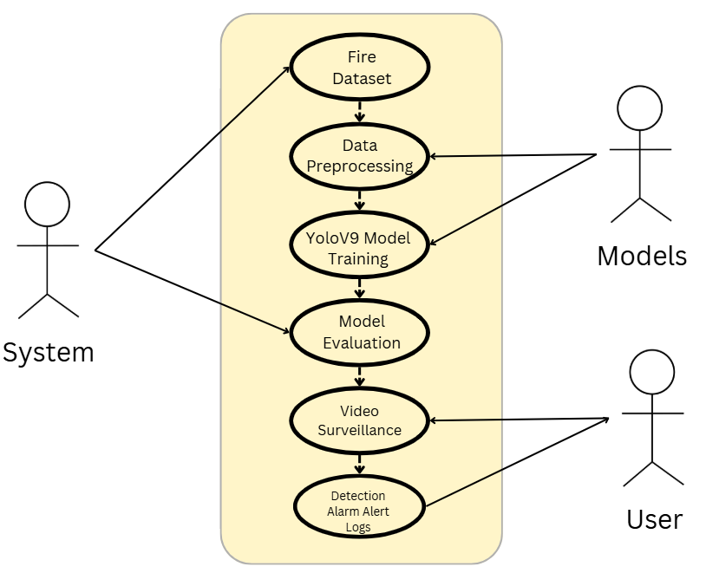
Use Case Diagram
The UML use case diagram for the proposed YOLOv9-based fire detection system represents the interactions between users and system components across all major stages, including dataset handling, preprocessing, model training, testing, and user interface operations. In the dataset stage, the user or administrator uploads fire and smoke image and video datasets, which are then preprocessed by the system through frame extraction, resizing, normalization, and annotation to ensure data consistency. During model training, the system uses the preprocessed dataset to train the YOLOv9 model, learning discriminative fire and smoke features, followed by model testing and validation to evaluate detection accuracy and reliability. In the deployment phase, the trained model is integrated with the user interface, where users can provide live camera input or recorded video for real-time fire detection.

Slide 9
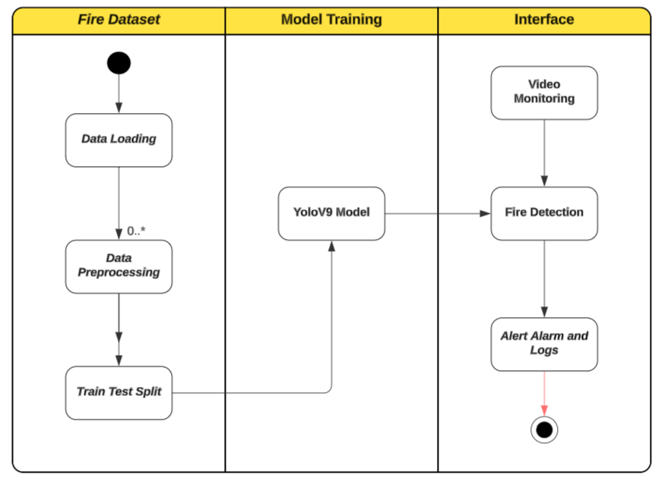
Activity Diagram
The activity diagram of the proposed YOLOv9-based fire detection system illustrates the complete operational workflow from data input to emergency response in a sequential and decision-driven manner. The process begins with capturing live video streams or loading recorded video data, followed by frame extraction and preprocessing to prepare the input for analysis. Each frame is then passed to the trained YOLOv9 model for fire and smoke detection, where a decision node checks whether fire or smoke is detected. If no fire is identified, the system continues monitoring the video stream; if fire or smoke is detected, the workflow proceeds to temporal validation, where detections are verified across consecutive frames to eliminate false alarms.

Slide 10
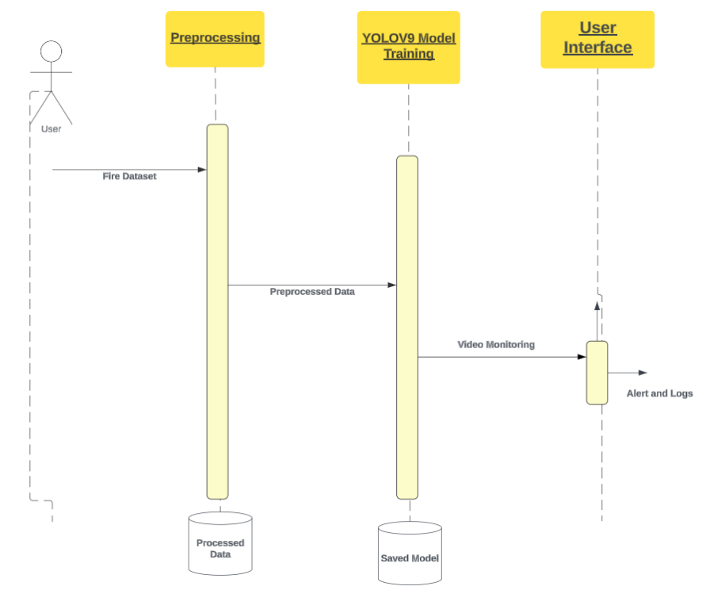
Sequence Diagram
The sequence diagram of the proposed YOLOv9-based fire detection system depicts the step-by-step interactions between the system components and the user for real-time fire monitoring and response. The sequence begins with the user or surveillance system providing live video input, which is sent to the preprocessing module for frame extraction, resizing, and normalization. The preprocessed frames are then passed sequentially to the YOLOv9 detection module, which analyzes each frame for fire or smoke and returns detection results along with confidence scores. These results are forwarded to the temporal validation module, where consecutive-frame consistency is checked to confirm genuine fire incidents and reduce false alarms. Once validated, the severity classification module determines the intensity of the fire as low, medium, or high. Based on the classification, the alert generation module automatically triggers emergency notifications, while the logging module records event details such as time, severity, and confidence scores for future analysis.

Slide 11
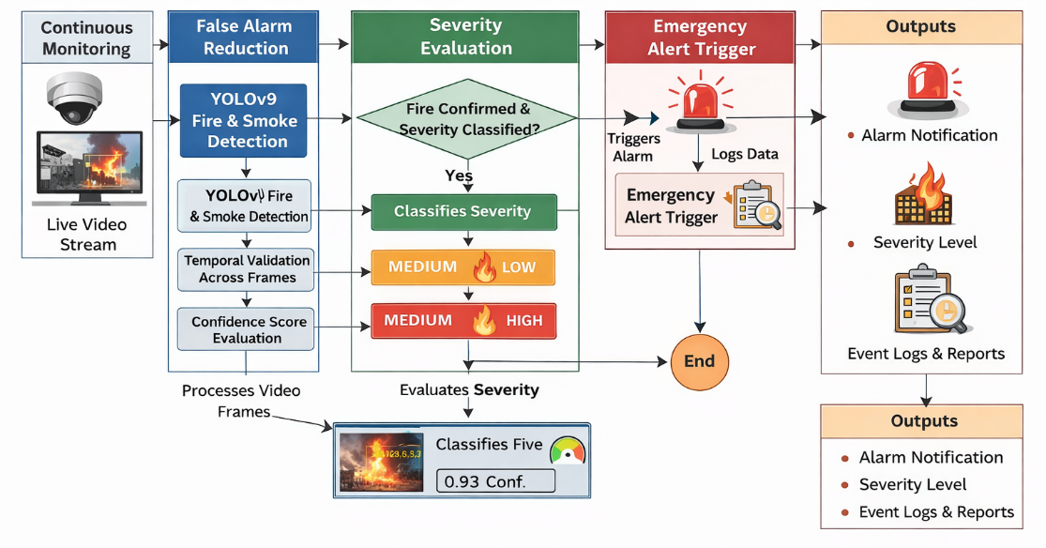
System Architecture
Proposed Model Architecture

Slide 12
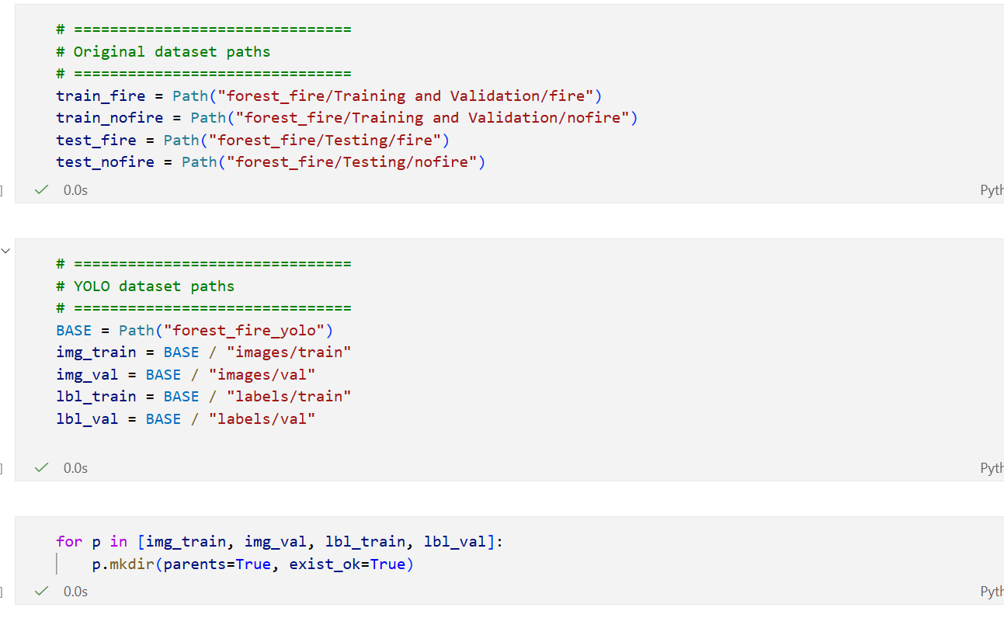
Outputs
Loading Datasets

Slide 13
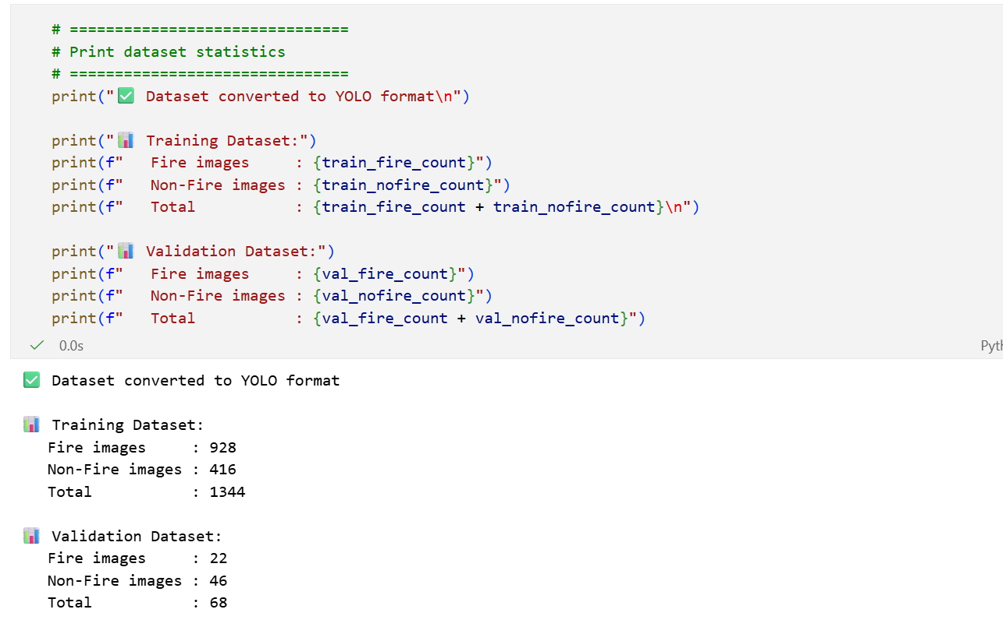
Outputs
Dataset Statistics

Slide 14
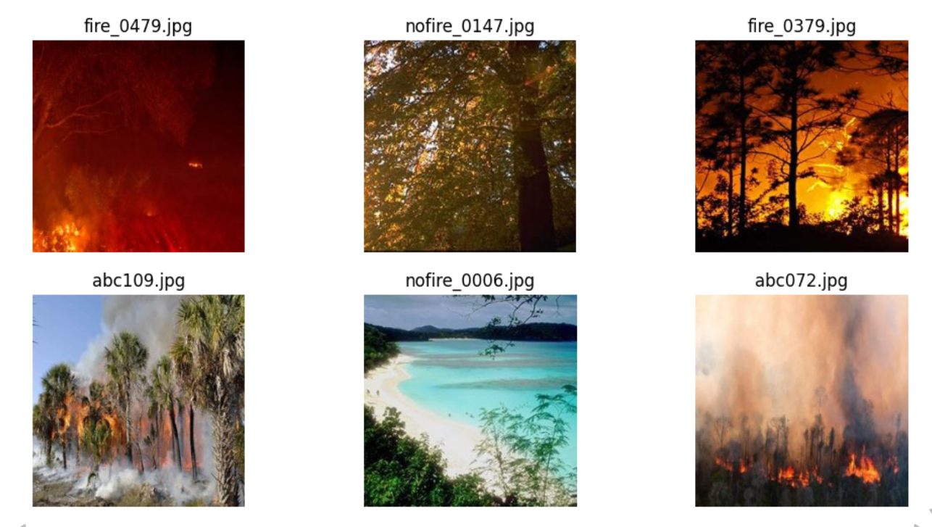
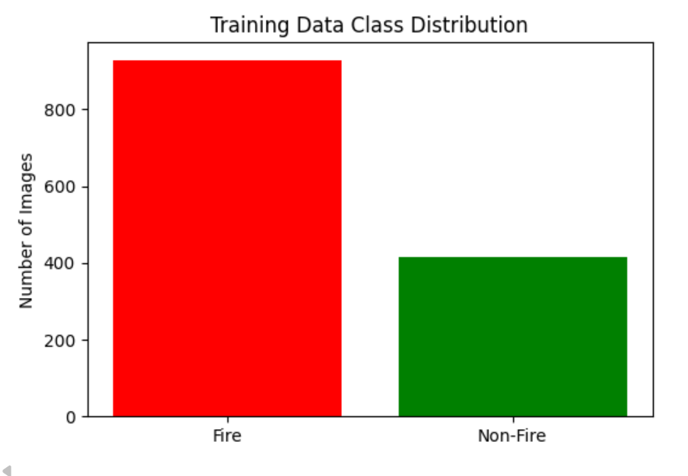
Outputs
Sample Images of Data

Slide 15
Conclusion
The proposed YOLOv9-based fire detection system provides accurate and real-time detection of fire and smoke from live video streams, significantly improving early warning capabilities compared to traditional methods.
Temporal validation across consecutive frames effectively reduces false alarms caused by environmental factors such as dust, lighting variations, and reflections, enhancing system reliability.
The system’s severity classification and automatic emergency alert generation enable prioritized response and rapid action, minimizing potential damage and ensuring safety.
Comprehensive event logging allows for post-incident analysis, performance evaluation, and continuous system improvement, making the framework robust, scalable, and suitable for real-world fire monitoring and disaster management applications.

Slide 16
References
Remmelzwaal, L. (2025). An AI-based early fire detection system utilizing HD cameras and real-time image analysis. In Artificial Intelligence and Applications.
Morchid, A., Alblushi, I. G. M., Khalid, H. M., El Alami, R., Said, Z., Qjidaa, H., ... & Jamil, M. O. (2025). Fire detection and anti-fire system to enhance food security: A concept of smart agriculture systems-based IoT and embedded systems with machine-to-machine protocol. Scientific African, 27, e02559.
Salaria, A., & Singh, A. (2025). A guide for selection of wireless communication technology for effective and robust early forest fire detection system. Bulletin of Electrical Engineering and Informatics, 14(2), 1026-1035.
Wilk-Jakubowski, J. L., Loboichenko, V., Divizinyuk, M., Wilk-Jakubowski, G., Shevchenko, R., Ivanov, S., & Strelets, V. (2025). Acoustic Waves and Their Application in Modern Fire Detection Using Artificial Vision Systems: A Review. Sensors (Basel, Switzerland), 25(3), 935.
Mia, M. M. (2025). A REVIEW ON THE INFLUENCE OF AI-ENABLED FIRE DETECTION AND SUPPRESSION SYSTEMS IN ENHANCING BUILDING SAFETY. Review of Applied Science and Technology, 4(04), 36-73.

Slide 17
Thank You

Slide 18
Any Queries

